Slide 1

Research Progress Record
Enmao Diao¹ Jie Ding² Vahid Tarokh¹
¹Duke University ²University of Minnesota-Twin Cities

Slide 2
Overview
Heterogeneous Federated Learning
Gradient Assisted Learning
Multimodal Controller for Continual Generative Models
Compressing Turbulence
Finite Neural Networks
Others
Preliminary Exam
Dissertation

Slide 3
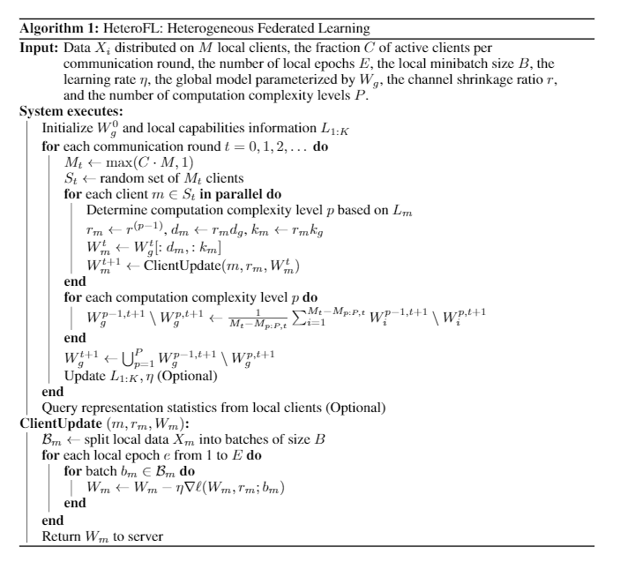
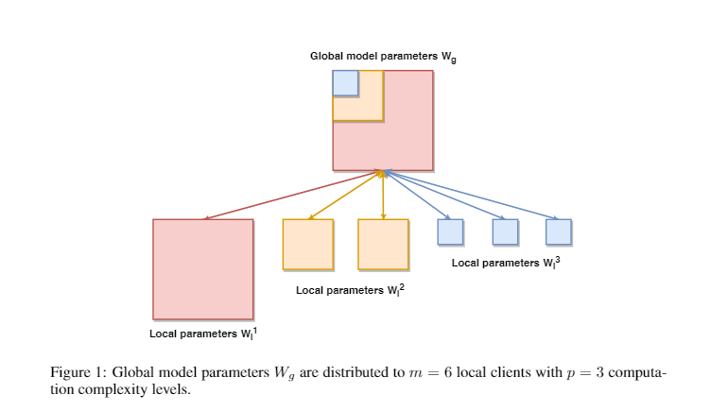
Heterogeneous Federated Learning
Camera-Ready version submitted to ICLR 2021

Slide 4
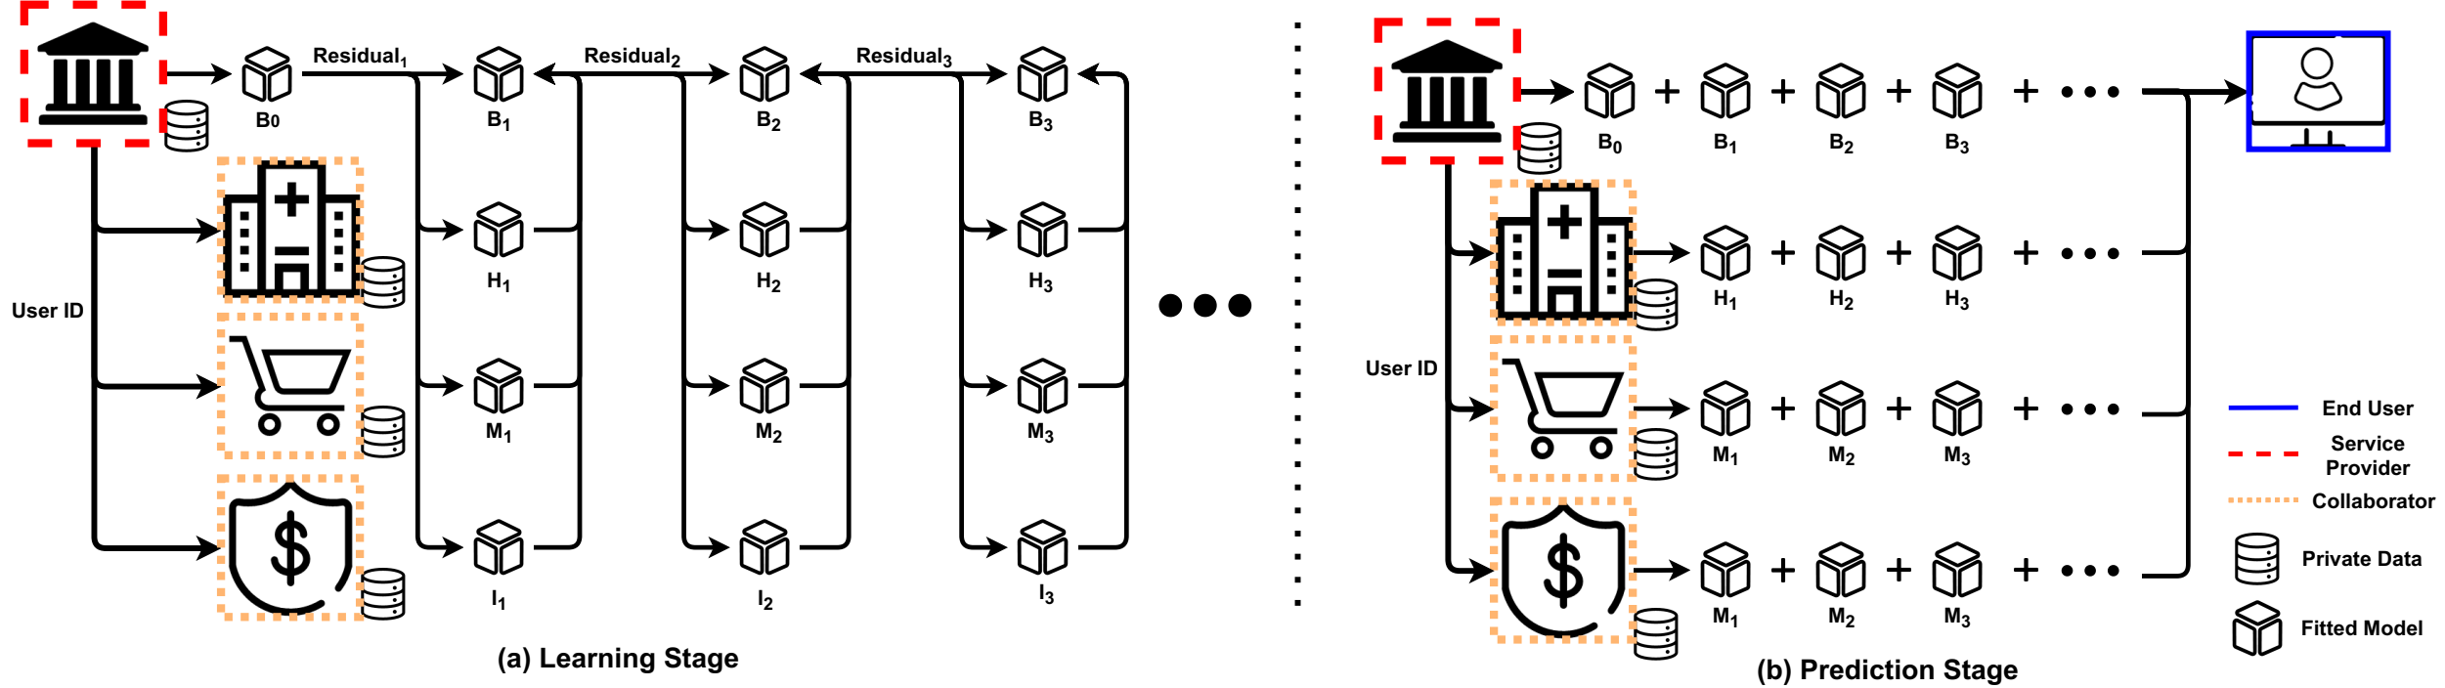
Gradient Assisted Learning
Submitted to ICML 2021
Train vertically split data in model agnostic setting (Assisted Learning A Framework for Multi-Organization Learning)
We combine boosting and ensemble method. Specifically, each iteration each local learner fits a pseudo-residual from gradient boosting and combine the output from broadcasting from other learners

Slide 5
Gradient Assisted Learning
Submitted to ICML 2021
Train vertically split data in model agnostic setting (Assisted Learning A Framework for Multi-Organization Learning)
We combine boosting and ensemble method. Specifically, each iteration each local learner fits a pseudo-residual from gradient boosting and combine the output from broadcasting from other learners

Slide 6
Multimodal Controller for Continual Generative Models
Paper submitted to ICASSP got rejected
We plan to shift the focus from conditional generative model to continual generative models with subnetworks for various classes coming sequentially
Prepare for ICCV (Mar 10) or ACMMM (Apr 03)
Supervising a student working on GAN with siren networks

Slide 7
Distributed Learning
ECE 590 Edge Computing project
Local Data, Local Model (no transmission of data and model parameters)
Data-Free Federated Distillation (First attempt): Use data-free knowledge distillation as a way of communication and aggregation. Proxy data: related data, intermediate features, random noises.
Boosting on Edge (Second attempt): End, Edge, Cloud each hosts a model to train the residual passing from lower level. End device is the lowest and has all the data. The features and residuals are transmitted to next level. Multiple iteration of boosting may also work.
Prepare for NIPS 2021, AAAI 2021

Slide 8
Assisted recommendation system
Use gradient assisted learning to train vertical-split recommendation data
Multiple organization (companies) collaboratively learn a recommendation system
Prepare for AAAI 2021, ICDM 2021 (June 11, 2021), KDD2022, WWW 2022

Slide 9
Compressing Turbulence
We focus on VQ-AE for compressing turbulence data (naïve-stokes)
Finalizing VQ-AE architecture
Prepare for Physics Review Fluid

Slide 10
Finite Neural Networks
Input, weights and output are all on finite field
I find formal derivatives can be defined for finite field with product rule of calculus
In mathematics, the formal derivative is an operation on elements of a polynomial ring or a ring of formal power series that mimics the form of the derivative from calculus.
https://en.wikipedia.org/wiki/Formal_derivative
For example d(X^5)/dx = 5X^4 which means summation of X^4 5 times. d(f(X)/5)/dx = 1/5 d(f(X))/dx in finite field means find a value that when add 5 times equal d(f(X))/dx.
I think it is feasible to implement Finite Neural Networks with these definition.

Slide 11
Model Picking
Model Picking without knowing training data and target model
Copy a model by training a generator to efficiently generate query and ask prediction from trained models (MAZE_ Data-Free Model Stealing Attack__Using Zeroth-Order Gradient Estimation)
We carefully seek for new queries and use less budget to pick the model
We found that
Naïve data-free knowledge distillation does not work with deep models, noises will have single class output
White box model can use adversarial loss to facilitate generation of meaningful output (more than one class)

Slide 12
Others
Deep Channel Coding
Frequency domain or wavelet-based channel coding with Fourier operator
Defend adversarial attacks from intermediate layers
Hypothesis: Even though we only change very little to the input image and easily attack trained neural network. Intermediate layer features should have a very different distribution from the trained dataset. The change of result cannot happen within one layer. It is the deep nature makes classifier fragile
Design a simple Defensive BatchNorm to check statistics
Neural PDE sover
Fourier operator
Wavelet operator
SIREN network

Slide 13
Others
Neural Wavelet Transform
Train the kernel inside wavelet to replace convolution layer to reduce computation and kernel size
Possible extend to other integral transform
Apply for compression and classification
Predictive gradient descent, meta-learning
Forget about learning rate. Theoretically there always exists a best gradient step at each iteration. We use learning history as our training data and predict the best gradient step. Deep Learning for optimization.

Slide 14
Preliminary Exam
Scheduled on Apr 9th 2-3pm
Committee:
Vahid Tarokh
Yiran Chen (Minor Area Representative)
Jeffrey Krolik
David Carlson
Maria Gorlatova
Aspects of Distributed Learning
HeteroFL
Gradient Assisted Learning

